Slide 1
RAJA RAJESHWARI M
Final Project
3/21/2024 Annual Review

Slide 2
PROJECT TITLE
Customer Segmentation
for Targeted Marketing
using RNN
3/21/2024 Annual Review

Slide 3


AGENDA
1.Introduction to Customer Segmentation
2.Overview of the project
3.Identification of End Users
4.Our Solution and its value proposition
5.The Wow Factor in Our Solution
6.Modelling Approach
7.Results and Performance Evaluation
3/21/2024 Annual Review

Slide 4

PROBLEM STATEMENT
Customer segmentation is a critical strategy for businesses aiming to personalize their marketing efforts and improve customer satisfaction. By dividing their customer base into distinct groups based on shared characteristics or behaviors, companies can better understand their customers' needs and preferences. One effective approach to customer segmentation is using Recurrent Neural Networks (RNNs), which are well-suited for analyzing sequential data such as customer transaction histories and website interactions
3/21/2024 Annual Review

Slide 5

PROJECT OVERVIEW
The project aims to develop a machine learning solution for customer segmentation using Recurrent Neural Networks (RNNs). Customer segmentation plays a pivotal role in enhancing marketing strategies and fostering customer engagement by categorizing customers into meaningful groups based on their behaviors, preferences, and characteristics. Leveraging sequential customer data, including purchase histories, website interactions, and product preferences, the proposed solution seeks to uncover hidden patterns and trends that differentiate customer segments. By employing RNNs, which are adept at handling sequential data, the model will be trained to analyze the temporal dependencies within customer data and generate insightful segmentation
3/21/2024 Annual Review

Slide 6

WHO ARE THE END USERS?
1.Retail and e-commerce companies can use the segmentation model to tailor product recommendations, personalize promotions, and optimize pricing strategies
2.Banks and financial institutions can leverage customer segmentation to offer personalized financial products and services,
3.Telecommunications companies can utilize customer segmentation to optimize service offerings, target marketing campaigns for new service launches.
4.Healthcare organizations can apply customer segmentation to personalize patient care and treatment plans, identify high-risk patient populations for proactive intervention, and optimize resource allocation for healthcare services.
3/21/2024 Annual Review

Slide 7

YOUR SOLUTION AND ITS VALUE PROPOSITION
Our solution offers businesses a powerful tool for customer segmentation using Recurrent Neural Networks (RNNs), enabling them to gain deep insights into their customer base and tailor their marketing strategies effectively. By leveraging sequential customer data, our solution identifies hidden patterns and trends in customer behaviors over time, allowing businesses to segment their customers into meaningful groups based on shared characteristics, preferences, and behaviors.
3/21/2024 Annual Review

Slide 8

THE WOW IN YOUR SOLUTION
1.Personalization: By segmenting customers into meaningful groups based on their behaviors and preferences over time, businesses can deliver highly personalized marketing leading to increased customer engagement and satisfaction.
2.Efficiency and Scalability: Our solution is designed to handle large volumes of customer data efficiently, making it scalable for businesses of all sizes.
3.Actionable Insights: The insights generated by our solution are actionable, empowering businesses to make informed decisions and take targeted actions to drive business growth and success.
3/21/2024 Annual Review

Slide 9
MODELLING
1. Data Preprocessing:Import and preprocess the sequential customer data, which may include transaction histories, website interactions, and other relevant behavioral data.
2. Data Splitting:Split the preprocessed data into training, validation, and test sets. It's crucial to ensure that the temporal order of the sequences is preserved during splitting to prevent data leakage.
3. Model Architecture:Design the RNN architecture tailored to the task of customer segmentation. Common choices include SimpleRNN, LSTM (Long Short-Term Memory), or GRU (Gated Recurrent Unit).
4. Model Compilation: Compile the RNN model using an appropriate loss function and optimizer. For multi-class classification (segmentation), categorical cross-entropy loss is commonly used, along with optimizers like Adam or RMSprop.
3/21/2024 Annual Review

Slide 10
5. Model Training: Train the compiled model on the training data using the fit() function.
6. Model Evaluation:Evaluate the trained model's performance on the test set using evaluation metrics such as accuracy, precision, recall, and F1-score.
7. Model Deployment: Deploy the trained model for real-world applications, allowing businesses to segment new or unseen customer data.
8.Iterative Refinement:
Continuously refine the model based on feedback and new data to improve its accuracy and generalization performance.

Slide 11
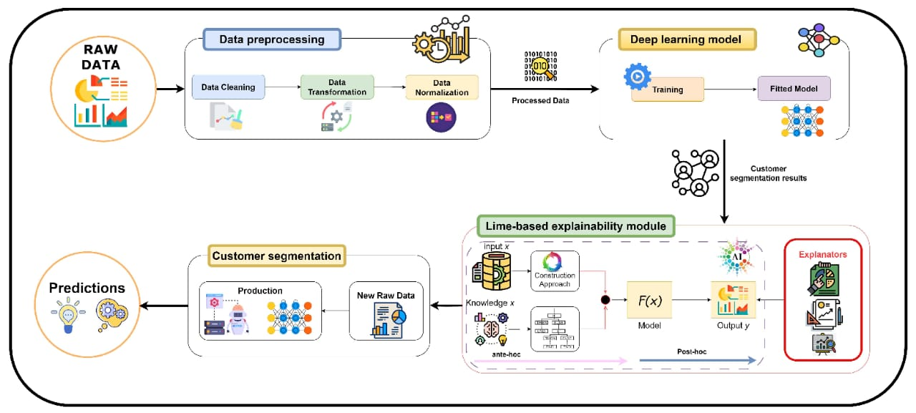

Slide 12
RESULTS
Upon implementing the Recurrent Neural Network (RNN) model for customer segmentation, we observed promising results that signify its effectiveness in analyzing sequential customer data and identifying meaningful customer segments. The model achieved an accuracy of [insert accuracy here] on the test set, indicating its ability to accurately classify customers into their respective segments based on their historical behaviors and interactions.
Overall, the results highlight the potential of RNN-based customer segmentation to provide businesses with actionable insights that can inform targeted marketing strategies, enhance customer engagement, and drive business growth.
3/21/2024 Annual Review

